Slide 1
ClubLife
Connecting Students and Student Organization Clubs
Zach Babka, Sasha Hedges, Jonathan Merklin, Brandon Poole

Slide 2
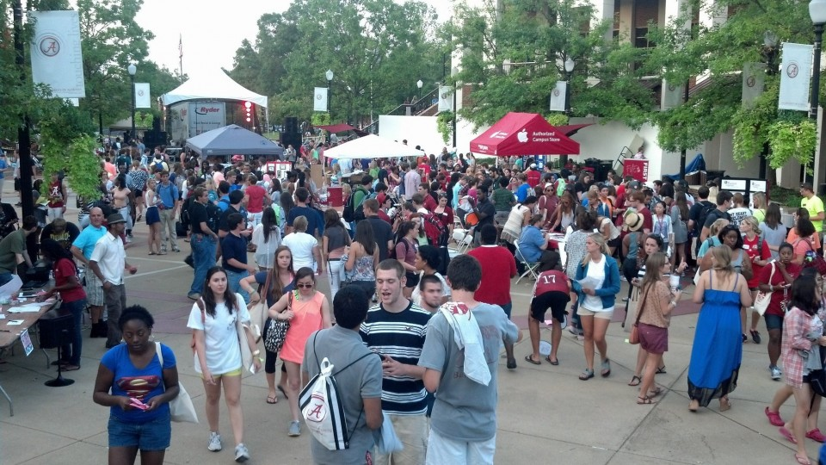
http://blog.al.com/tuscaloosa/2012/09/ua_students_flock_to_get_on_bo.html

Slide 3
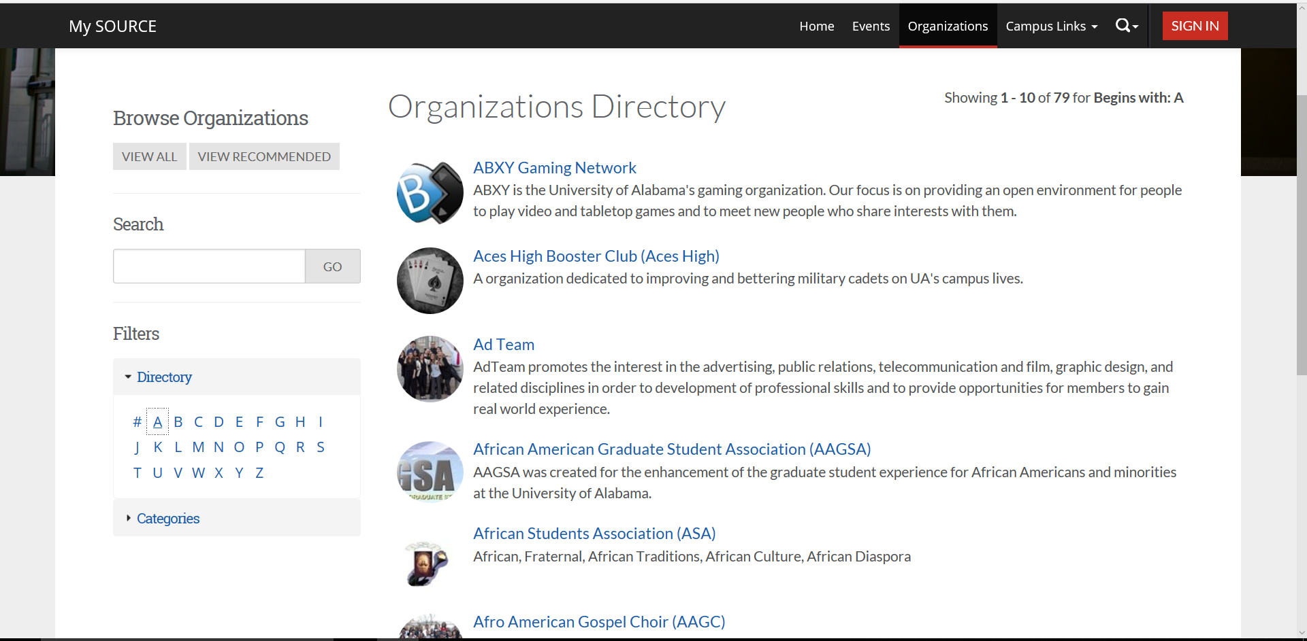

Slide 4
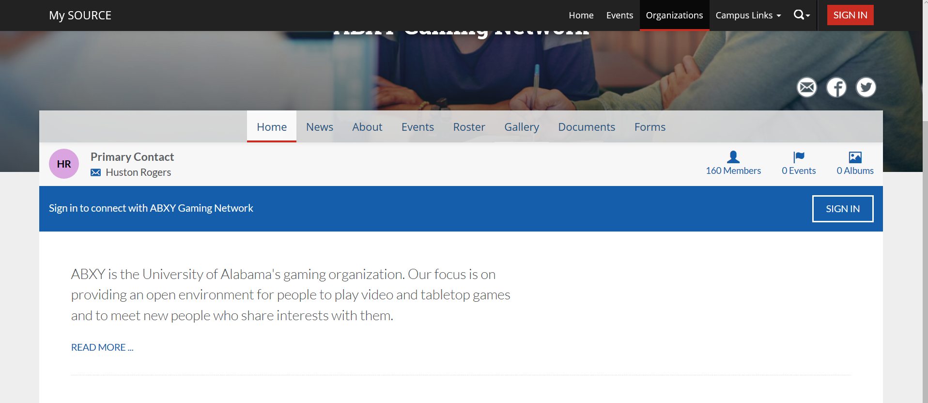

Slide 5



What is this missing?
Tues
5:15 pm
Thurs
7:00 pm
Tues, Wed
6:00 pm

Slide 6

ClubLife would:
Organize students’ club life:
Add meeting times to Google Calendar
Receive notifications for meeting times
Keep all current clubs in one location
Notes:
Clubs promote: send to meetings
Public posting section
Contact information to officers
Documents
Add to “my clubs”
Give notifications for meetings

Slide 7

ClubLife would:
Help club leaders communicate with members:
Notify members about updates and meetings
Allow club to communicate with other clubs
Post relevant documents
Notes:
Clubs promote: send to meetings
Public posting section
Contact information to officers
Documents
Add to “my clubs”
Give notifications for meetings

Slide 8
Questions?
Zach Babka (zababka@crimson.ua.edu)
Sasha Hedges (avhedges@crimson.ua.edu)
Johnathan Merklin (jamerklin@crimson.ua.edu )
Brandon Poole (bcpoole@crimson.ua.edu)

